Slide 1
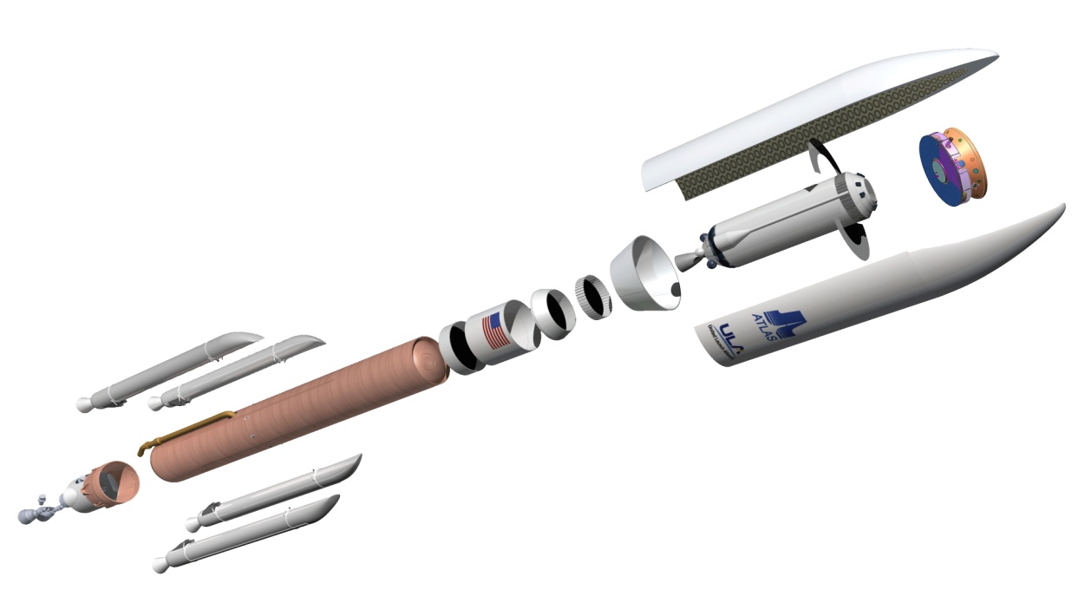
SETELLITE LONCHING VEHICLE

Slide 2
LOUNCH VEHICLE
launch vehicle or carrier rocket is a rocket used to carry a payload from Earth's surface into outer space. A launch system includes the launch vehicle, the launch pad, and other infrastructure.^{[1]} Although a carrier rocket's payload is often an artificial satellite placed into orbit, some spaceflights, such as sounding rockets, are sub-orbital, while others enable spacecraft to escape Earth orbit entirely.
Earth orbital launch vehicles typically have at least two stages, and sometimes as many as four or more.

Slide 3
TYPES
Launch vehicle are classified as
1. Expendable launch vehicle –Delta &
Ariane rockets
2. Reusable launch vehicle –space shuttle or
STS

Slide 4
Expendable Launch Vehicle
An expendable launch system is uses to carry a payload into space. The vehicle used in expendable launch systems are design to used only once ( i.e. they are “ expended ” during a single flight ), and there components are not recovered for re-use after launch.

Slide 5
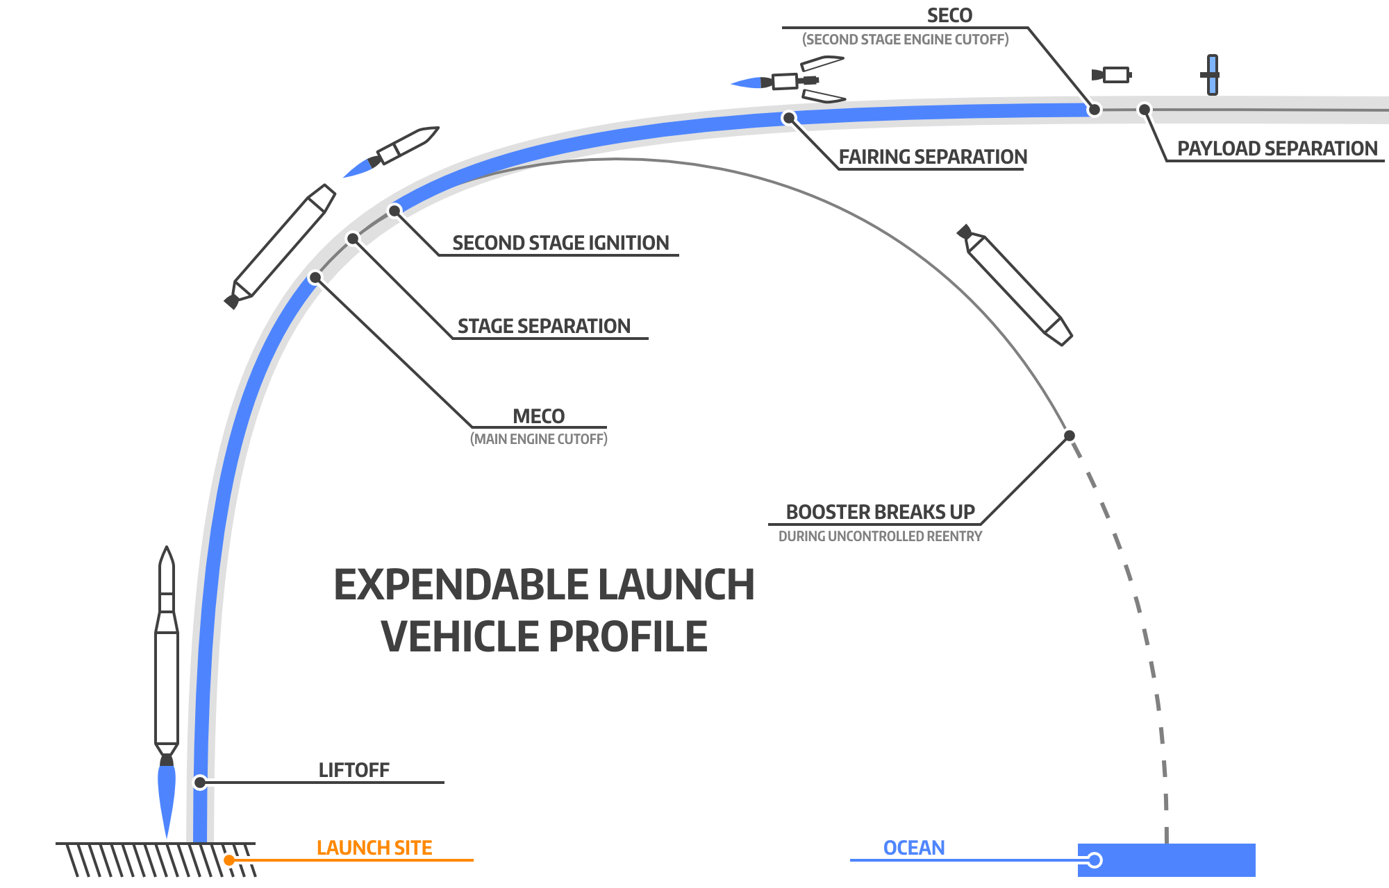

Slide 6
Reusable Launch Vehicle
A reusable launch system is capable of launching a payload into space more than once. No completely reusable orbital launch system.
The space shuttle was partially reusable:
- space shuttle main engines
- two solid rocket boosters
Where reusable after several months of refitting work for each launch. The external tank and launch vehicle load frame where discarded after each flight.

Slide 7
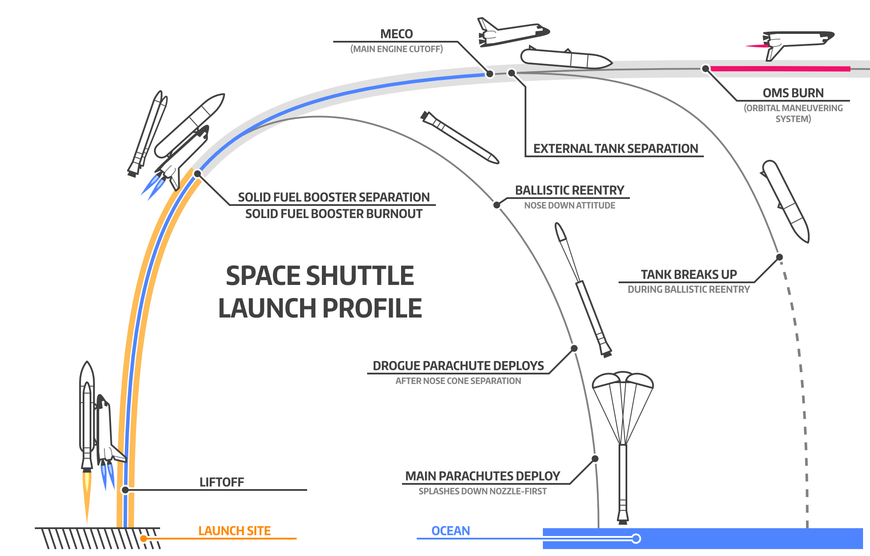

Slide 8
HOW A LOUNCH VEHICLE WORKS??
A launch vehicle is a good illustration of Newton’s third low of motion, “For every action, there is an equal and opposite reaction”.
In the case of a launch vehicle: “action”= flow out the rear vehicle of exhaust gases produced by the combustion of the vehicle’s fuel in it’s rocket engine. “reaction”= pressure
called thrust, applied to the internal structure of the launch vehicle that pushes it in the direction opposite to the exhaust flow. Unlike jet engines, which operates on the same action-reaction principle but obtain the oxygen needed for burning their fuel from the atmosphere, rockets carry with them their own oxidizing agent. In that way, they can operate in the vacuum beyond the atmosphere.

Slide 9
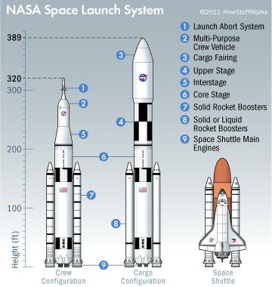

Slide 10
HOW A LOUNCH VEHICLE WORKS??
The primary goal of launch vehicle designers is to maximize the vehicle’s weight-lifting capability while at the same time providing an adequate level of reliability at an acceptable cost.
Achieving a balance among this three factors is challenging. In order for the launch vehicle to lift off of Earth, it’s upward thrust must be greater then the combined weight of it’s spacecraft payload, the vehicle’s propellants, and the structure.
This puts a premium on making the vehicle’s mechanical structure, fuel tanks, and rocket engines as light as possible but strong enough to withstand the forces and stresses associated with rapid acceleration through a resistant atmosphere. Most often, propellant makes up 80% or more then total weight of a launch vehicle-spacecraft combination prior to launch.

Slide 11
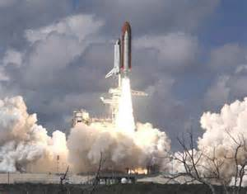

Slide 12
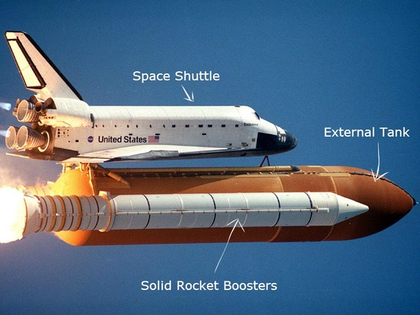
What happens to the space shuttle’s external tank after it disconects?

Slide 13
EXTERNAL TANK
The orange external tank is jettisoned 10 seconds after MECO (main engine cut off) and falls back to earth , but it’s not re-used. It doesn’t have any parachutes and is designed to break apart before landing in the ocean(out of way any ship).

Slide 14
B00STERS
The solid rocket boosters detach at about 45km and keep rising to about 67km before filling back to earth.
They depends parachutes once back in the atmosphere and drop into ocean roughly 200km from the launch site, where they’re recovered by two NASA recovery ships. The boosters are then refurbished and reused for the next launch.

Slide 15
SHUTTLE ASSMBLY
The space shuttle is connected to the external fuel tank, which is then connected to the two solid rocket boosters.
The boosters carry the weight of the entire shuttle and external fuel tank when sitting on the launch pad and provide most of the power to get the vehicle to space.

Slide 16
FUEL
The fuel use to power rockets.
fuel can be divided into three broad categories:
- Liquid
- Solid
- hybrid

Slide 17
SOLID
The space shuttle was launched with the help of two solid –fuel booster known as SRBs.
Solid fuel rocket can remain in stages for long periods, and than reliably launch on short notice, they have been frequently used in military applications such as a missiles.
Solid rocket are used as light launch vehicles for low earth orbit.

Slide 18
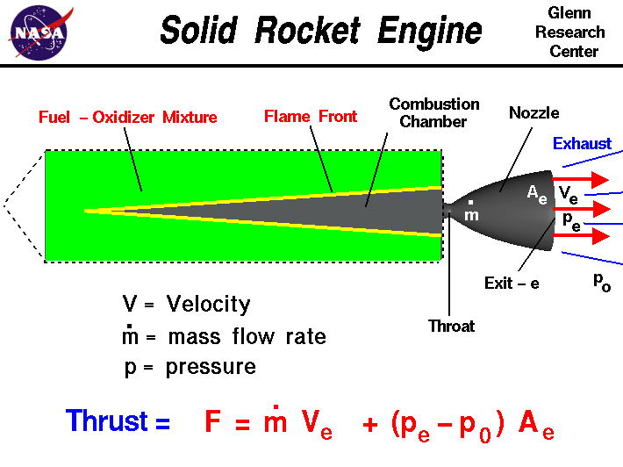
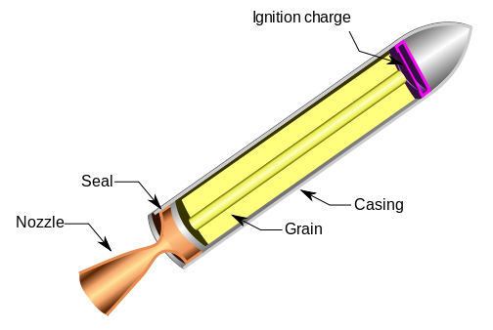

Slide 19
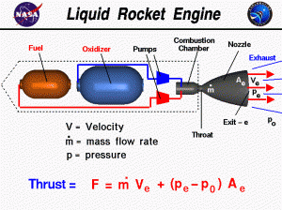
LIQUID
Liquid rocket is a rocket engine that uses liquid propellants. Liquids are desirable because their reasonably high density allows the volume of the propellant tanks to be use lightweight centrifugal.

Slide 20
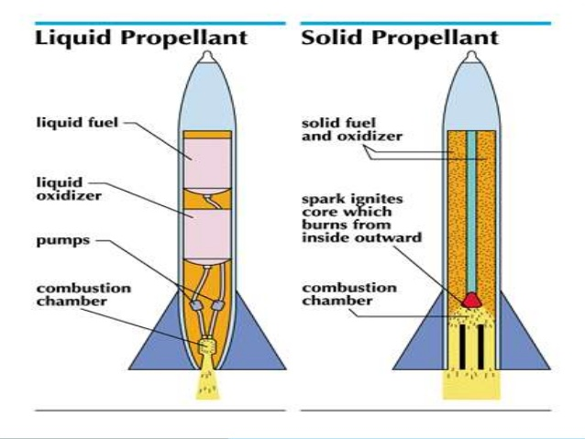

Slide 21
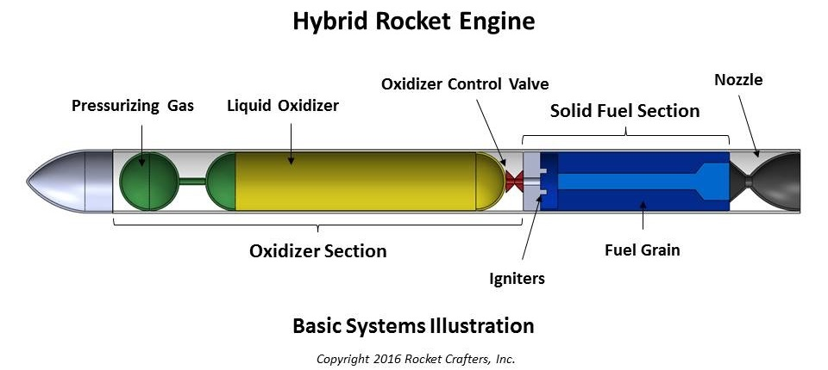
HYBRID
A hybrid propellant rocket is a rocket is a rocket with a rocket propellants in two different phase one solid and other gas or liquid.

Slide 22
THANK YOU

